Slide 1
ANALYSIS
in student performance
DATA
Notes:
ISDS

Slide 2
Group 2 TEAM MEMBERS
QUANG NGUYEN
ALEX CHUOY
JIAYI GUO
DONGQING GU
GIA LUONG

Slide 3
TABLE OF CONTENTS
INTRODUCTION
MLR
01
05
DATA OVERVIEW
KNN
02
06
RELATED RESEARCH PAPERS
CART
03
07
DATA CLEANING
Final summary
04
08
Notes:
Introduction
Data Overview and Data Cleaning
MLR
KNN
CART
Summary and Conclusion

Slide 4
INTRODUCTION
WHY STUDENT PERFORMANCE DATA ?
First Data Set Was Too Complicated - Stock Exchange Data
Thousands of records and hundred of attributes
Ultimately Chose With Student Performance
Notes:
Question for this slide: Do we need to talk about this part? Can be delete we do not have time.

Slide 5
DATA OVERVIEW
Grade school students’ performance in Portuguese
649 observations
33 variables
Goal: Want to determine which factors had the biggest influence on students’ final grade.
Notes:
We had two data sets originally, math and portuguese.
The math set was the smaller of the two, we did do the work on it, but the professor said to only focus on one.

Slide 6
3 RELATED RESEARCH PAPERS
The Relationship between Admission Exam and Students' Performance on an Undergraduate Interior Design Program
Internet Use Behavior Model for Predicting Students' Performance
Relationship between E-learning and Student Performance

Slide 7
THE RELATIONSHIP BETWEEN ADMISSION EXAM AND STUDENTS' PERFORMANCE ON AN UNDERGRADUATE INTERIOR DESIGN PROGRAM
Abstract : The article investigates the relationship between admission exam and students' performance on an interior design program
Sample Size: 50 Students
Methods: Paired samples testing and linear regression analysis were performed.
Result: There is no significant relationship between admission exam (skill exam) and students' performance.

Slide 8
INTERNET USE BEHAVIOR MODEL FOR PREDICTING STUDENTS' PERFORMANCE
Abstract : proposing a specific Internet Use behavior (IUB) classification model to discover comprehensive prediction models on students' performance by using educational data mining (EDM)
Sample Size: 469 undergraduate students
Methods: Clustering, classification, correlation, and regression
Result: Online gaming has a negative significant effect on the students' performance

Slide 9
RELATIONSHIP BETWEEN E-LEARNING AND STUDENT PERFORMANCE
Abstract : investigating the relationship of service quality dimensions (tangibility, responsiveness, assurance, reliability, empathy, and e-learning) on student's academic performance through student motivation, and student satisfaction.
Sample Size: 384 participants studying in higher education
Methods: Non-probability convenience sampling technique and questionnaire
Results: The relationship between service quality dimensions (tangibility, responsiveness, assurance, reliability, empathy, and e-learning) and student's academic performance is partially mediated through student's motivation and student satisfaction.
Notes:
1-9 Slides Quang
2-3 mins
Presentation 22-28 minutes
Each person only needs to present for min 2 minutes

Slide 10
DATA CLEANING

Slide 11
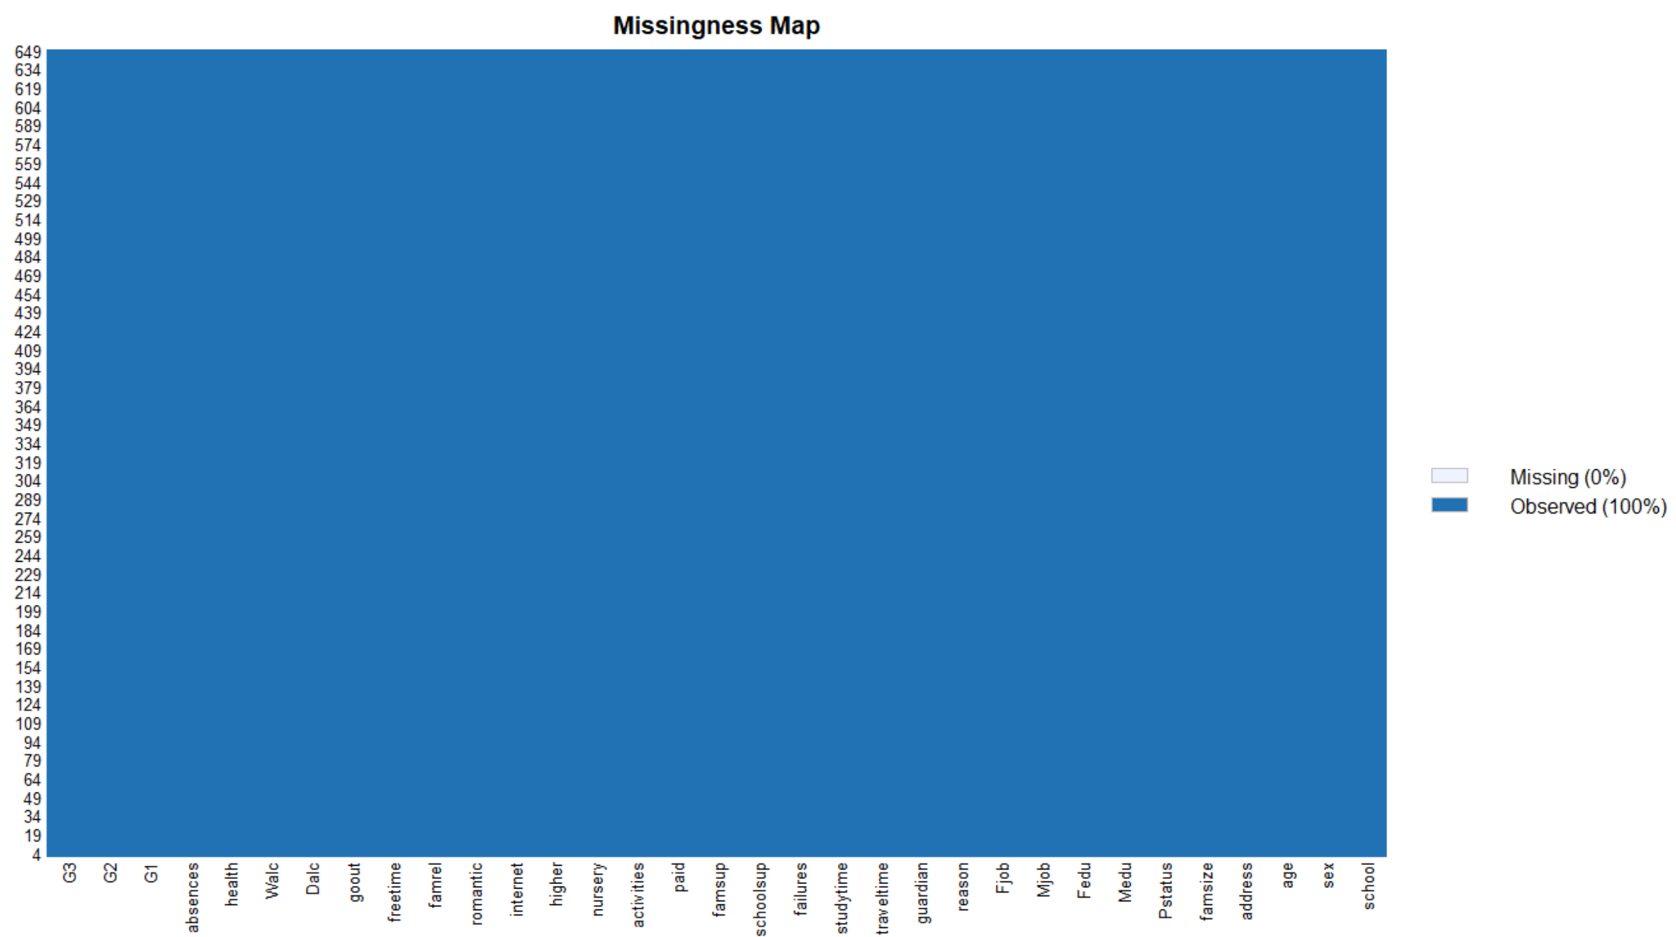
DATA CLEANING
No Missing Data Points; No Need to Delete Records or Attributes

Slide 12
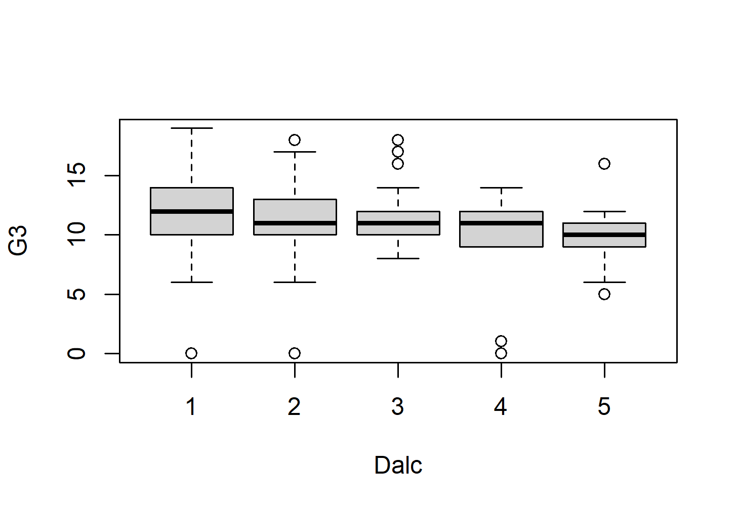
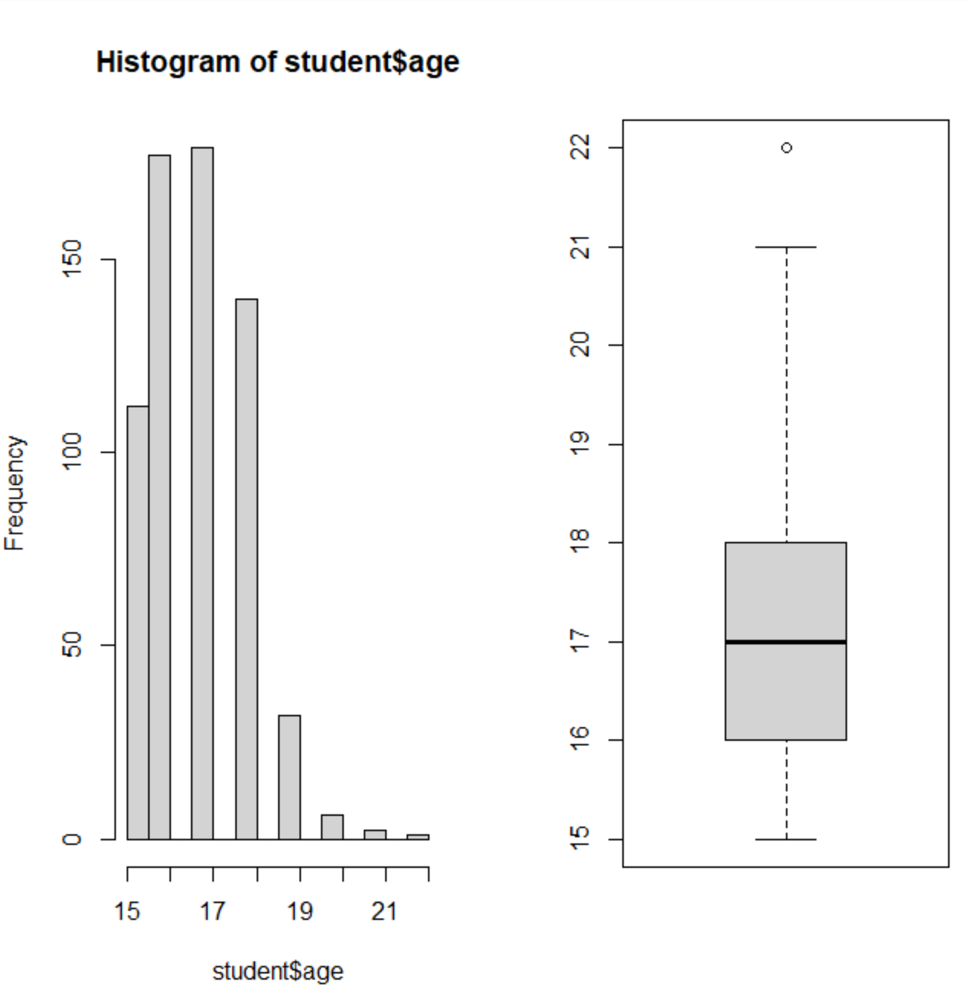
DATA CLEANING
CHECKING VARIABLES FOR DISTRIBUTION AND OUTLIERS
Some variables were on a scale from 1-5
Numerical or Categorical?
Used Boxplots to Check Linearity
Treat as Numerical for Simplicity
Professor’s Recommendation
Wouldn’t affect final results either way
The rest of the variables
Checked using histograms and boxplots
Relatively normal distributions for numericals
Categoricals weren’t skewed towards one main category
No huge outliers
Data was already small to begin with
Kept all data points

Slide 13
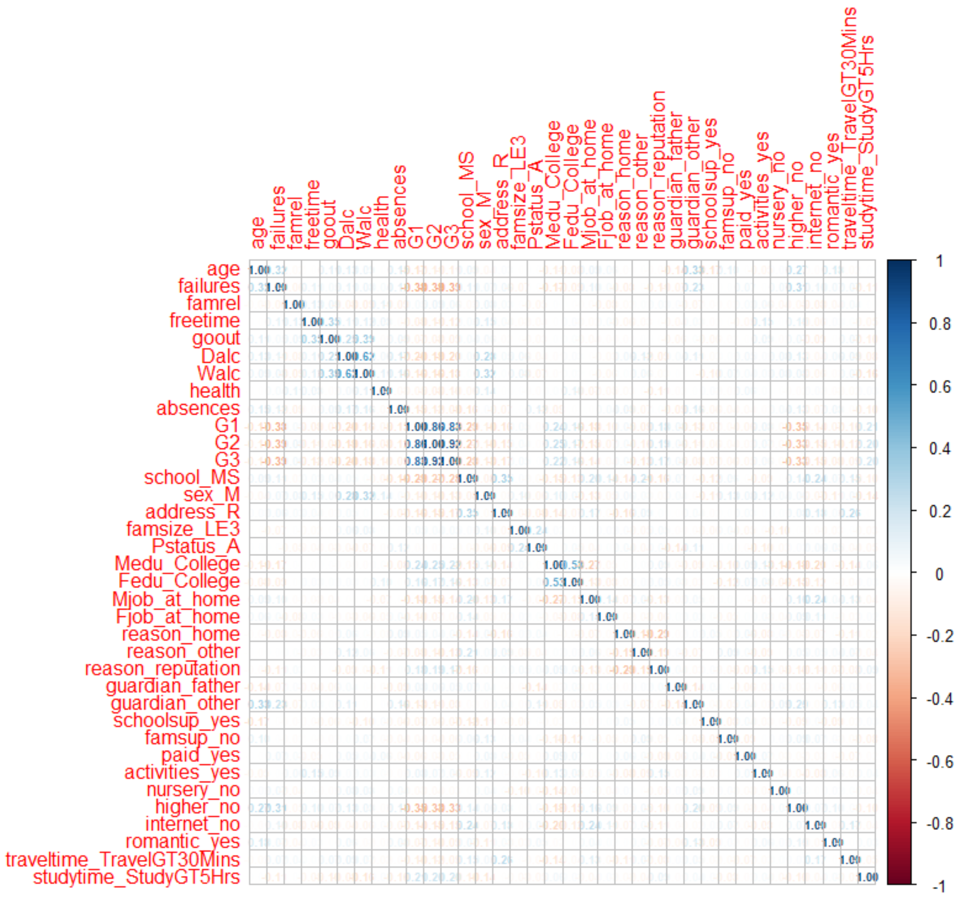
DATA CLEANING
COLINEARITY CHECK
No correlation between independent variables.
Correlation Stays Mainly Between ± .04
No Columns Deleted
The 3 dependent variables, G1, G2, and G3 were all highly correlated

Slide 14
DATA CLEANING
DUMMYING VARIABLE
Most variables were categorical
Needed to be dummied out so we can use them in models
Most Were Binary, Some had Multiple Options Like Primary Caregiver - Mother, Father, Other
CONSOLIDATION
Recommended by the Professor
Example Mother’s Job was condensed down from 5 categories to 2, Has a Job or Doesn’t Have a Job
REMOVED DATA
G1 & G2 were the grades for each semester separately
G3 was the final grade; combines G1 & G2
G1 & G2 were removed
Both were independent and dependent; G1 & G2 affected G3
Complicated the model
END RESULT
649 Observations and 35 variables
Notes:
Slide 8-13 data cleaning.
5 min: Current Practice Time 4 min 45 seconds - Alex

Slide 15
Mlr
(multiple linear regression)

Slide 16
MLR: CHOOSING THE BEST VARIABLES
Partition
Wanted to choose between 60-40 and 80-20
Ultimately chose the later
Used the same partition for the other models
3 Variable Selection Methods
Forward
Backward
Stepwise
All 3 Methods Led to the Same Result
Final Model Was Used for KNN and CART
Notes:
Partition
All 3 Models lead to the same result
Final Model was Used for KNN and CART

Slide 17
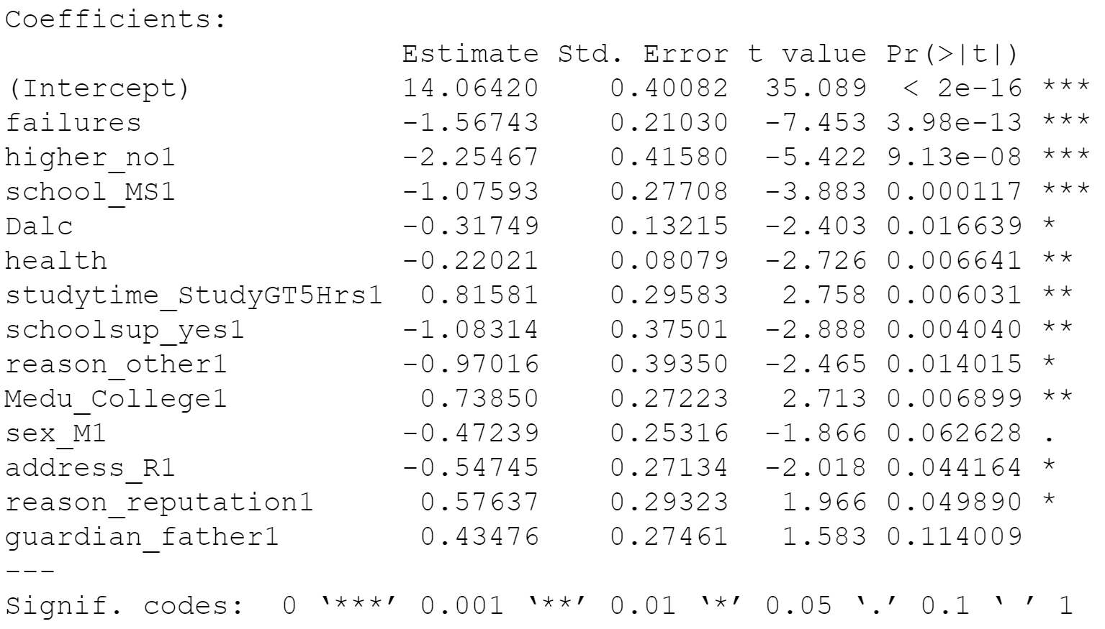
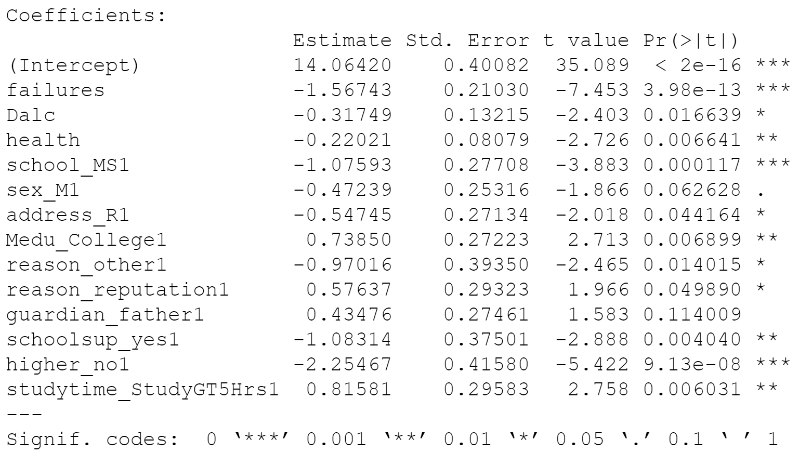
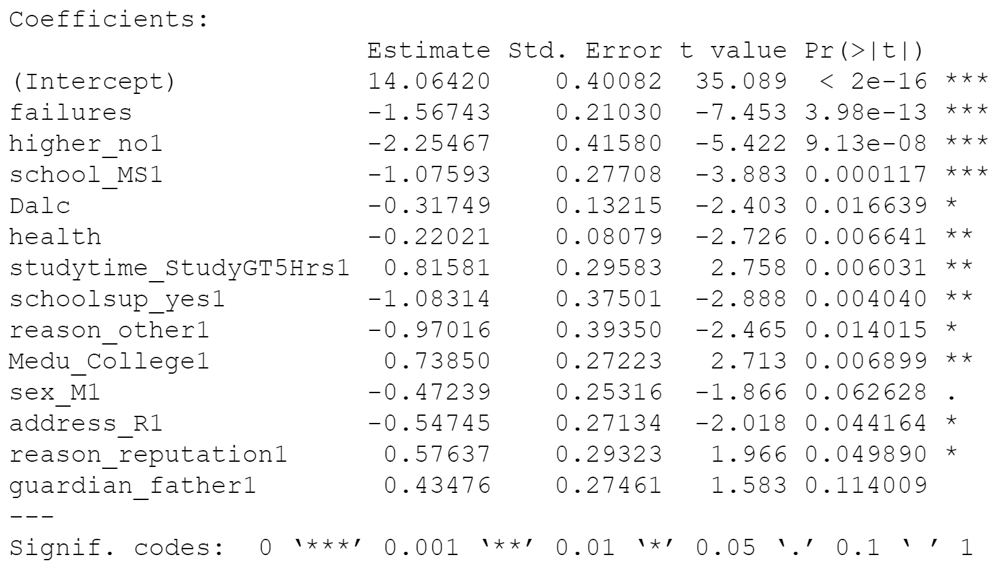
Mlr Final Model
Forwards
Backwards
Stepwise
Same RMSE for all Three Models : 2.844952
Same Exact Variables Chosen Just in a Different Order In the Case of Backwards Selection

Slide 18
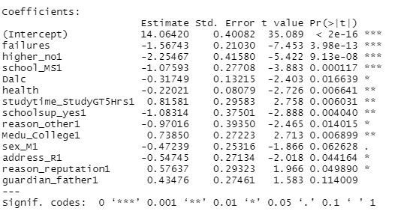
MLR ANALYSIS
Most Important Variables
Failures, Pursuit of Higher Education, Which School You Attend
Example Interpretations
Each Failure you had decrease your grade by 1.5 points
If the student didn’t pursue higher education, graded decrease by 2.2 points
If the Student attended Mousinho da Silveira (MS) their grade decreased by 1.07 points

Slide 19
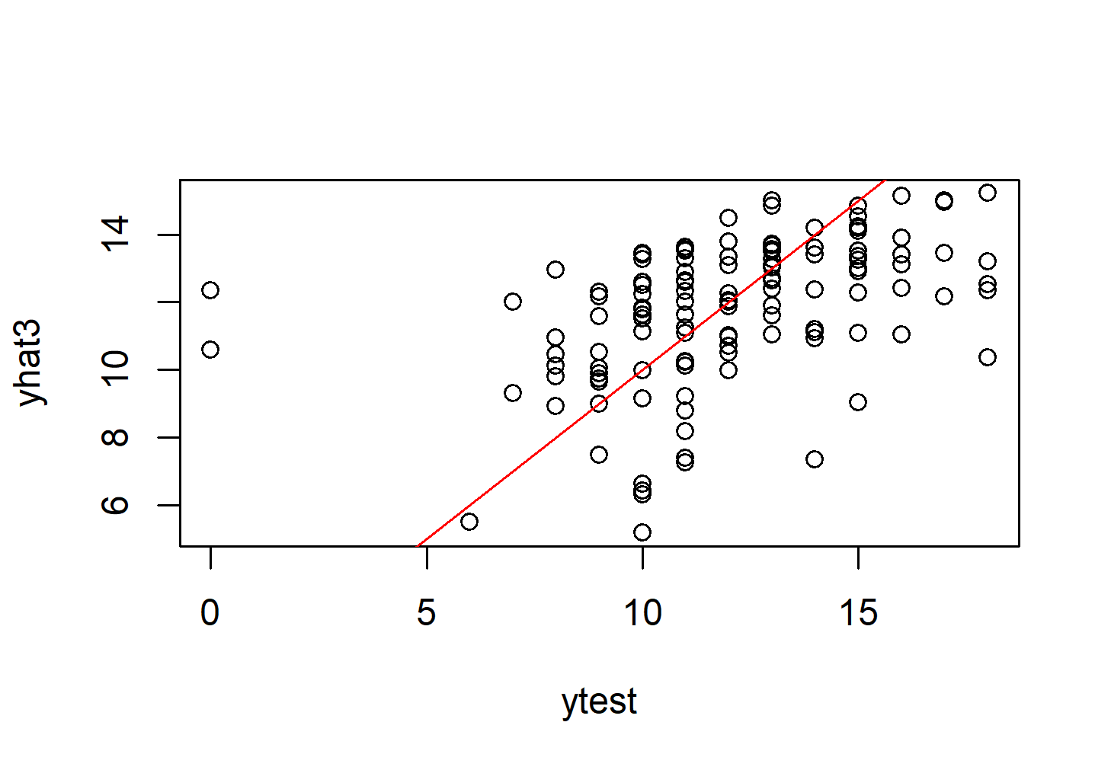
MLR ANALYSIS
Large Variance in the data prediction
Model prediction covers a smaller range of grades compared to G3 (about 6 - 16 vs 0 - 20)
Notes:
JiaYi MLR slides 14-17
~2 MIN
Consistently Under Predicts <- under predict for >15, over predict for <10

Slide 20
dat$G3 = 14.06420 - dat$failures*1.56743 - dat$higher_no*2.25467 - dat$school_MS*1.07593 - dat$Dalc*0.31749 - dat$health*0.22021 + dat$studytime_StudyGT5Hrs*.81581 - dat$schoolsup_yes*1.08314 - dat$reason_other*.97016 + dat$Medu_College*.73840 - dat$sex_M*.47239 - dat$address_R*.54745 + dat$reason_reputation*.57637 + dat$guardian_father*.43476 + error

Slide 21
Knn
(k-nearest neighbors)

Slide 22
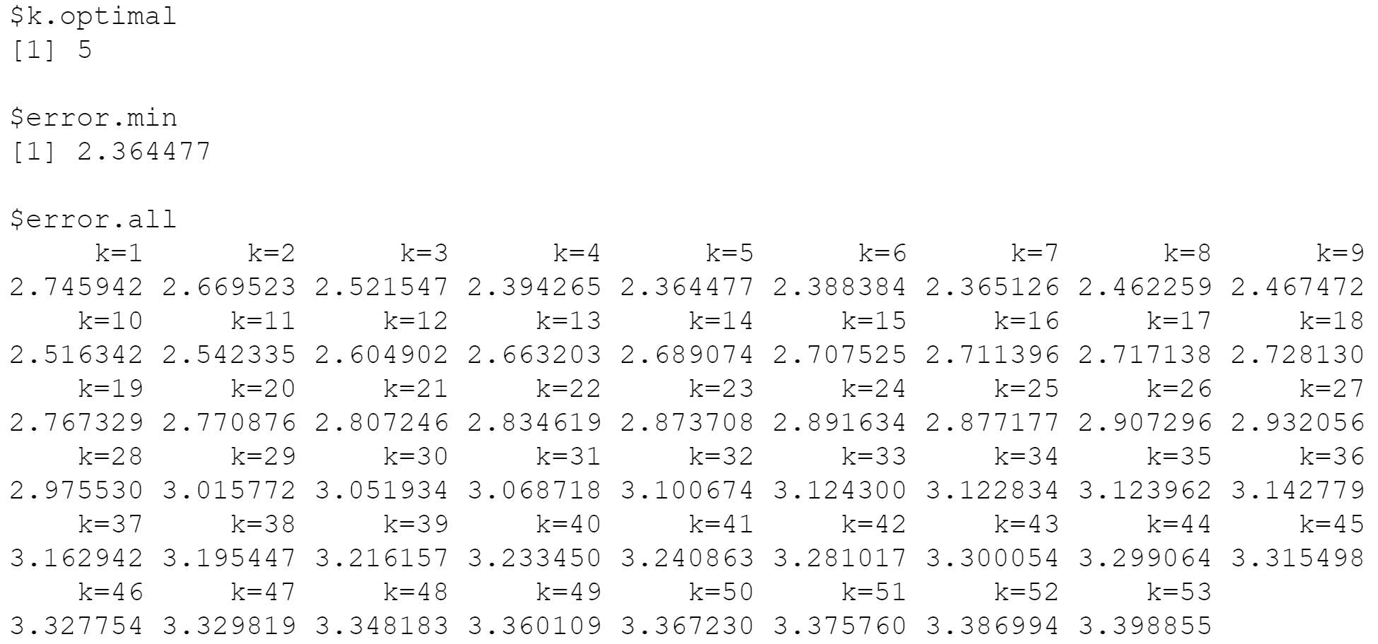
KNN: CHOOSING THE BEST K
Checked k = 1 up to 53
Best k = 5, RMSE = 2.364477
Error Rate increased after k = 5
Notes:
K is how many neighbors you compare; choose k by looking at which produces the lowest error; which in this case was 5
Questions for Alex:
k is 1 up to 65, not sure why 65? In the lecture note, it is mentioned up to 10% of the training data. Our training data is 80% * 649=519.
I guess i used a bigger number than needed, but it doesn't really change the results, k=5 is still the best result since the error rate continuously increase up to k=65
Even if the k is up to 65, why in the code, we use the following 1:40 for the grid?
I guess i forgot to save that change in the code; ill update it, it still doesnt change the results though
The image still gets the point across
obj1 = knn.predict.bestK(Xtrain, ytrain, Xtest, ytest, k.grid = 1:40)

Slide 23
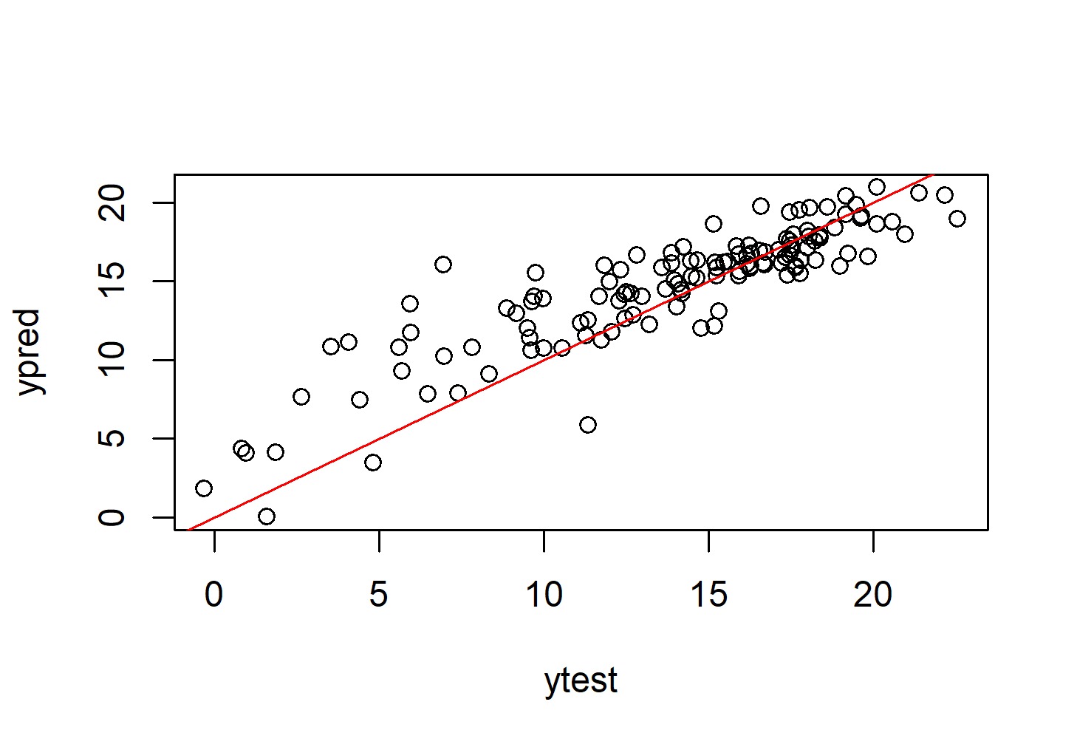
KNN ANALYSIS
Much better model than LMR
Lower Variance
As G3 gets lower, the model is more likely to overpredict
Notes:
KNN Slide 18-19 1:30 mins

Slide 24
Cart
(CLASSIFICATION AND
REGRESSION TREE)

Slide 25
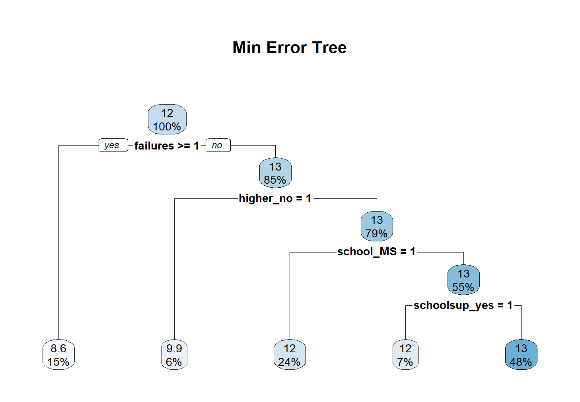

CART MINIMUM ERROR TREE
Used defaults
Max Tree Length - 30
Min Records Per Leaf - 7
RMSE = 2.742624
Chose the same 4 most significant variables chosen by LMR
Notes:
Hi Alex,
For the tree length, should it be 34 (There are 35 variable in total, and exclude G3, will be 34?), how did you get 30?
Tree Length is not related to the number of variables. The number layers in a tree for 35 variables can range anywhere from 7 in a optimal tree to 35 layers for a very bad tree
The code by default sets the length of the tree to 30. Our Model from MLR only choose 12 variables, so there was no need to change the default max length.
Where is said default is 30
Here is the documentation, max depth = 30
Type
Which type?
How did you get 7 for Min records per leaf? You mentioned 20/3, I don’t understand why 20/3?
By default minsplit = 20, it will not attempt to split a leaf with 20 records or less
Minbucket = round(minsplit/3) = round (20/3) = round(6.666666) = 7, no leaf can have less than 7 records
These are the default values when you run the rpart, so you don't need to specify them if you don't plan on changing the values
Why divided by 3? What’s the 3 mean? I got it, thanks. Just in case the professor will ask us to explain the numbers, which are required by the project.
That’s just how the code works? It's the default. I didn't decided it the developers did.
Just 3. I don't know why the developers chose that number in particular. You don't need to worry about it. Its what was hardcoded in by default, we didn't need to change it because we didn't need to. The dataset was not complicated enough to warrant changing the default values. Its fine, im sure he will understand if we just said we used the default values. The tree we got was small enough to understand.
I didn't change the default values since the tree would never get that deep or tried to split anything that small
If you ever wanted to check the documentation yourself. Run the code first then type ?rpart and ?rpart.control to see how it works
M
K is the minimum number of records that need to be in each leaf
Alex
1) the final R code name should be CART, not KART.
It's supposed to be CART i just misnamed it in the code
2) Why we choose k=10
This point was required based on the rubric
K is the minimum numbers of records a leaf can have; k is arbitrary here, just copied pasted from the professors code
None of the leaves got anywhere close to having 10 records, 649 * .06 = 38 records in the leaf with the smallest amount of records in it
More for Alex,
It seems k=10 is the cross validation. And you can see the our tree bottom leave have several <10.
Questions we need to answer
What parameters are used? - Used the model we got from MLR, mention in that section
Such as restriction on number of levels, minimum number of observations in each leaf, and so on. - Used the Defaults, updated the slides accordingly
in Records Per Leaf - 7

Slide 26
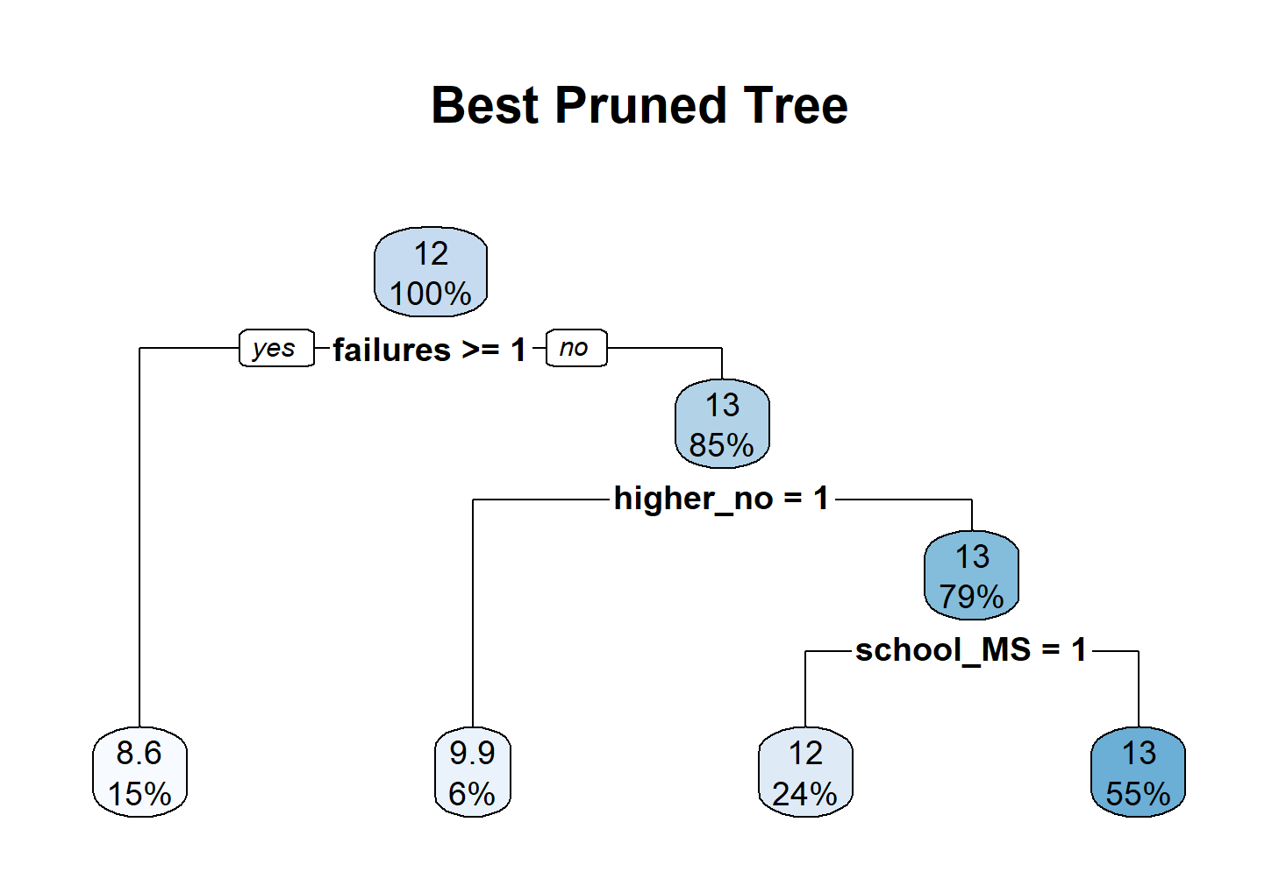
CART BEST PRUNED TREE
RMSE = 2.777794
Not that different from ME Tree
Only pruned one branch
3 most significant variables chosen by LMR
Notes:
Hi Alex, how to explain the last node 13(55%)-
if a student has no failure and have higher education desire and attend school 1,there are 55% chances he will get grade 13? Refer to full tree explanation below.
We covered this in class but i'll go over it again. The top number each each node is the average score. The bottom number is the percentage of data in that node.
For example the rightmost bottom leaf has an average score of 13, and that’s our prediction for all the students who are in that node. 55% of the students are in that node.
Does that mean 55% of the total students? Yes.
Is that mean within our dataset, the average score is 12, and 85% are 13, 15% are with avg grade 8.6
Let’s do this one layer at a time.
The top node has 100% of the dataset and the average score is 12.
– Failures
- 15% of students have more than one failures, and their average score is 8.6
- 85% of students do not have any failures, their average score is 13
-6% of students do not have any failures AND they do NOT plan to pursue higher education, their average is 9.9
-79% of students do not have any failures AND they plan to pursue higher education, their average is 13
-24% of students do not have any failures AND they plan to pursue higher education AND they go to MS, their average is 12
-55% of students do not have any failures AND they plan to pursue higher education AND they do NOT attend MS, their average is 13
This is how you interpret the entire tree, you don’t have to explain the entire tree though since the class can just read the tree and understand what this means.
Thank you so much!
No problem.

Slide 27
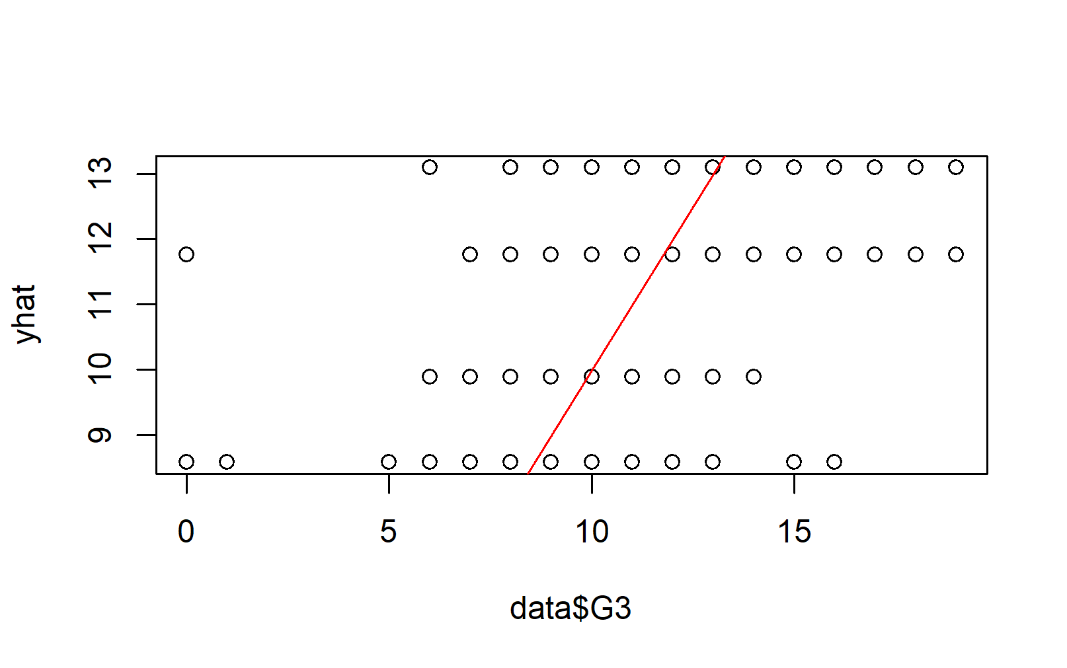
CART ANALYSIS
Very Bad Scatter Plot
Very Large Variance
Not Useful as a Regression Model
Only 4 groups
More Useful as a Categorization Model
Which Students are prone to failure?
Which Students are likely to succeed?
Notes:
Hi Alex, I will need your help to explain this slide

Slide 28
sUMMARY

Slide 29
POTENTIAL BIASES THAT COULD’VE SKEWED FINAL RESULTS
Initial Data Set was Small
Relatively small sample size
Not that many attributes
Some of the attributes were on a scale of 1-5; wasn’t rigorous
Pool of students was from a limited geographic area
Only students from Portugal
Only two schools were included in the study
Results were only for one class, Portuguese
There is a relatively higher proportion of students with higher grades compare to lower grades.

Slide 30
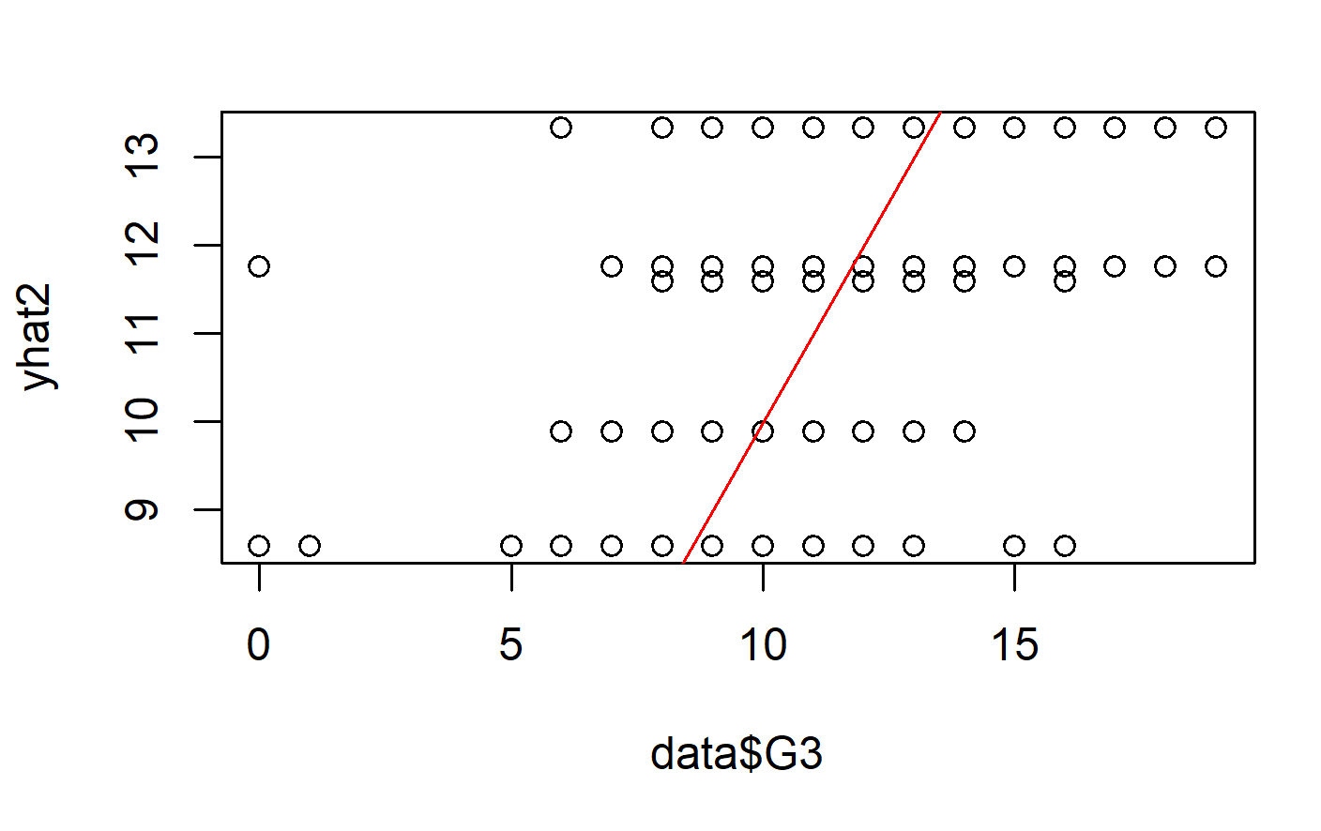
Summary | Accuracy
LMR
All three variable selection methods lead to the same exact model
RMSE = 2.844952
Model Under Predicts for higher values and over predicts for higher values.
It also has a Limited Range of Values
KNN
Best K = 5
RMSE = 2.364477
Model Consistently Over Predicts for Grades under 11.
CART
Minimum Error RMSE = 2.742624
Best Pruned RMSE = 2.777794
BP Tree Only Groups Students into 4 buckets for the sake of clarity.
Check Full Tree for more detailed categories
KNN displays better trend.
Similar RMSE for all 3; between 2-3
KNN has the best scatterplot

Slide 31
Summary | Decision Making
Past Failures, Pursuit of Higher Education and The School That You Attended are the three most important variables.
As policy makers, students past experiences, motivation and the school itself play an important role.
These might be a lead for policies that try to improve schools’ educational environment and having inspiring faculties.

Slide 32
Summary | Decision Making
Student health, studying time, parents education and extra at home school support play a secondary role to performance.
This means home environments, student self disciplines and well beings, generally out of school factors also contribute to their performance.
Only target these elements to refine the grades, after the most important issues has been resolved.

Slide 33
Potential Future Work
Math Data
Code was implemented, Analysis wasn’t
Told not to Include by Professor
Categorize the Grade
Determine Who Passes and Who Fails
G1 and G2
Do Multi-variable Analysis

Slide 34
REFERENCES
Original Dataset
http://archive.ics.uci.edu/ml/datasets/Student+Performance
Paper 1
https://www.proquest.com/openview/09bc1ddcaa1ac232f804c35c65477955/1/advanced
Paper 2
https://www.proquest.com/abicomplete/docview/2699820941/163B97F2F6F940C4PQ/7
Paper 3
https://www.proquest.com/abicomplete/docview/2701975549/163B97F2F6F940C4PQ/13

Slide 35
THANK YOU!

